Slide 1



SESSION NAME HERE
NON - LINEAR DATA STRUCTURES (Part 1)

Slide 2


Foundational Sessions Housekeeping
The use of disrespectful language is prohibited in the questions, this is a supportive, learning environment for all - please engage accordingly. (FBV: Mutual Respect.)
No question is daft or silly - ask them!
There are Q&A sessions midway and at the end of the session, should you wish to ask any follow-up questions. Moderators are going to be answering questions as the session progresses as well.
If you have any questions outside of this lecture, or that are not answered during this lecture, please do submit these for upcoming Open Classes. You can submit these questions here:
SE Open Class Questions or DS Open Class Questions

Slide 3
Foundational Sessions Housekeeping cont.
For all non-academic questions, please submit a query: www.hyperiondev.com/support
Report a safeguarding incident: www.hyperiondev.com/safeguardreporting
We would love your feedback on lectures: Feedback on Lectures

Slide 4


Reminders!
Guided Learning Hours
By now, ideally you should have 7 GLHs per week accrued. Remember to attend any and all sessions for support, and to ensure you reach 112 GLHs by the close of your Skills Bootcamp.
CONFIDENTIAL

Slide 5
Progression Criteria
✅ Criterion 1: Initial Requirements
Complete 15 hours of Guided Learning Hours and the first four tasks within two weeks.
✅ Criterion 2: Mid-Course Progress
Software Engineering: Finish 14 tasks by week 8.
Data Science: Finish 13 tasks by week 8.
✅ Criterion 3: Post-Course Progress
Complete all mandatory tasks by 24th March 2024.
Record an Invitation to Interview within 4 weeks of course completion, or by 30th March 2024.
Achieve 112 GLH by 24th March 2024.
✅ Criterion 4: Employability
Record a Final Job Outcome within 12 weeks of graduation, or by 23rd September 2024.
CONFIDENTIAL

Slide 6

Trees
Binary Trees
Binary Search Trees
Tree Traversal

Slide 7

The Role of Binary Trees in Data Organisation
Consider an e-commerce platform with an extensive product catalog organised hierarchically.
Challenges
Efficient searching and updating products.
Managing complex hierarchical relationships between products and categories.

Slide 8
Solution with Binary Trees
Ideal for sorted data.
Operations like search, insert, and delete can be optimised.
Solution with Binary Search Trees
Ideal for organizing ordered data efficiently.
Maintain a hierarchical structure based on value comparisons.
Offer dynamic operations while ensuring logarithmic time complexity for search, insertion, and deletion.
Real-World Impact: Improved performance in querying and managing hierarchical data, essential for a seamless user experience on the platform.

Slide 9

Example: Visualising Binary Tree
Throughout the lecture we’ll use the phrases “Binary Tree” and “Binary Search Tree” interchangeably, but our focus is on the commonly used Binary Search Tree which has differences to the Binary Tree and will be explained in a few slides
Let’s use a tool developed by VISUALGO.NET to show dynamic visualisations (as documented in the slides for convenience 🙂)

Slide 10
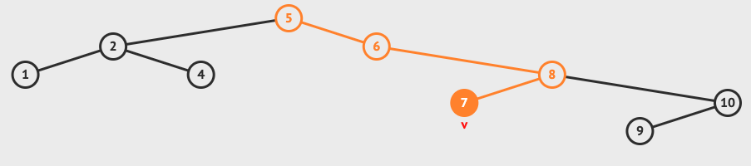
Let’s assume we have products with ids {5, 6, 2, 1, 8, 10, 9, 4, 7} that were received in this order and need to be documented
Notice if we search for 7, we’ll search a total of 3 nodes before finding it, instead of through a set of 9 elements. Similarly, inserts and deletes are more efficient. For massive datasets this becomes indispensable to a large company

Slide 11
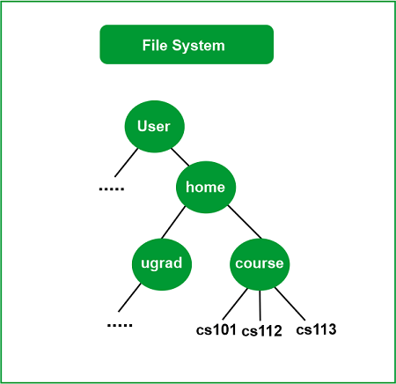
Trees

Slide 12
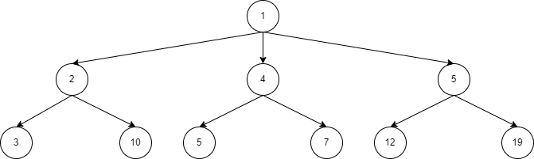
Binary Trees
A tree structure where each node has at most two children
Properties
Hierarchical structure with a single root.
Each node has zero, one, or two children.

Slide 13
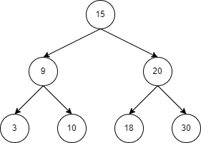
Binary Search Trees (BSTs)
A type of binary tree where each node has a key, and every node's key is greater than all keys in its left subtree and less than all keys in its right subtree.

Slide 14
Trees Traversal
Traversing means accessing each element of data structure at least once.
Inorder Traversal
Traverse the left subtree (L)
Visit the node (V)
Traverse the right subtree (R)
Preorder Traversal
Visit the node (V)
Traverse the left subtree (R)
Traverse the right subtree (L)
Post Order Traversal
Traverse the left subtree (L)
Traverse the right subtree (R)
Visit the node (V)

Slide 15
Trees Traversal
Inorder Traversal (LVR)
Visited Node: Null

Slide 16
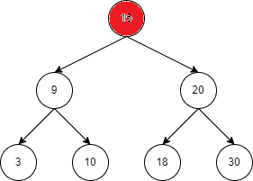
Trees Traversal
Inorder Traversal (LVR)
Visited Node: Null

Slide 17
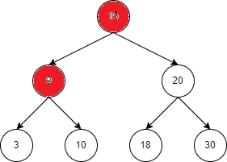
Trees Traversal
Inorder Traversal (LVR)
Visited Node: Null

Slide 18
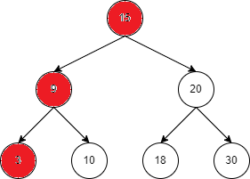
Trees Traversal
Inorder Traversal (LVR)
Visited Node: Null

Slide 19
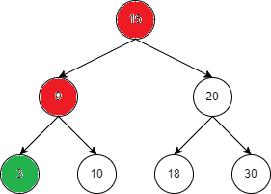
Trees Traversal
Inorder Traversal (LVR)
Visited Node: 3,

Slide 20
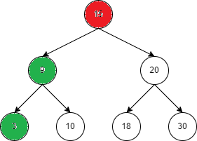
Trees Traversal
Inorder Traversal (LVR)
Visited Node: 3, 9,

Slide 21
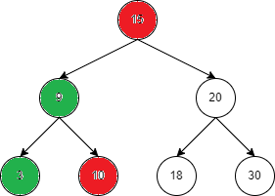
Trees Traversal
Inorder Traversal (LVR)
Visited Node: 3, 9,

Slide 22
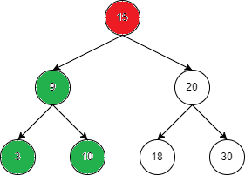
Trees Traversal
Inorder Traversal (LVR)
Visited Node: 3, 9, 10,

Slide 23
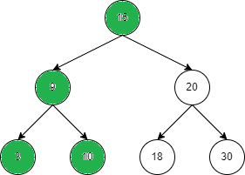
Trees Traversal
Inorder Traversal (LVR)
Visited Node: 3, 9, 10, 15

Slide 24
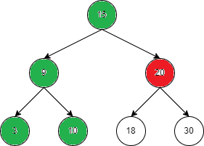
Trees Traversal
Inorder Traversal (LVR)
Visited Node: 3, 9, 10, 15

Slide 25
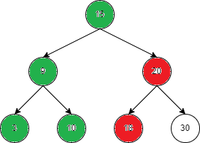
Trees Traversal
Inorder Traversal (LVR)
Visited Node: 3, 9, 10, 15

Slide 26
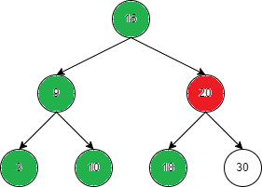
Trees Traversal
Inorder Traversal (LVR)
Visited Node: 3, 9, 10, 15, 19,

Slide 27
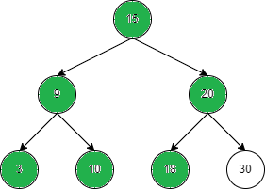
Trees Traversal
Inorder Traversal (LVR)
Visited Node: 3, 9, 10, 15, 19, 20,

Slide 28
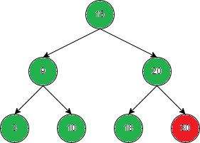
Trees Traversal
Inorder Traversal (LVR)
Visited Node: 3, 9, 10, 15, 19, 20,

Slide 29
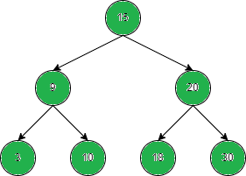
Trees Traversal
Inorder Traversal (LVR)
Visited Node: 3, 9, 10, 15, 19, 20, 30

Slide 30
Trees Traversal
Inorder Traversal (LVR)
Visited Node: 3 9 10 15 19 20 30
Preorder Traversal (VLR)
Visited Node: 15 9 3 10 20 19 30
Postorder Traversal (LRV)
Visited Node: 3 10 9 19 30 20 15

Slide 31
Trees Traversal
Inorder Traversal (LVR)
In-Order Traversal will print values in increasing order (BST)or from the leftmost leaf to the rightmost one
Preorder Traversal (VLR)
Pre-order traversal is used to create a copy of the tree
Postorder Traversal (LRV)
Postorder traversal is used to delete the tree from leaves nodes to the root.

Slide 32
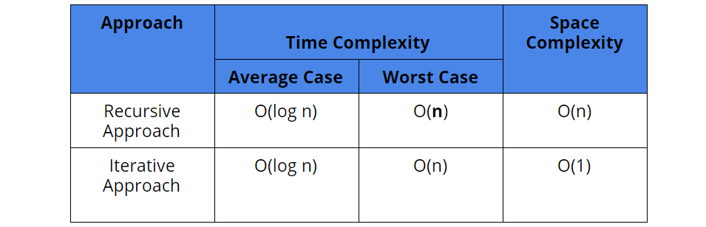

Slide 33
Other Types of Trees
B-Trees
AVL Tree
Red-Black Tree
Segment Tree

Slide 34


Thank you
for joining us
Take regular breaks
Stay hydrated
Avoid prolonged screen time
Practice good posture
Get regular exercise
“With great power comes great responsibility”

Slide 35


Questions and Answers
Questions around Non-Linear Data Structures Part 1

